Slide 1
Welcome slide

Slide 2
Implementing governance and compliance for modern applications
GRC373
Josh Kahn (he/him)
Rodrigo Bersa (he/him)
Tech Leader, Serverless
AWS
Senior Solutions Architect, Containers
AWS
Notes:
Many organizations trying to modernize often struggle with implementing governance and compliance. For modern containerized or serverless applications, this challenge is magnified due to their distributed and ephemeral nature. In this session, learn how to design and create purpose driven GRC solutions on AWS for modern applications. See how to use AWS services such as AWS Control Tower, AWS Config, AWS Systems Manager and AWS Lambda to get insights for identifying, analyzing and mitigating risk at scale.
Governance: https://solutionsreview.com/cloud-platforms/cloud-governance-creating-a-framework-for-success-in-the-cloud/
Governance basically refers to policies or protocols that increase the efficiency of that cloud environment, without which your company will be operating blindly in the cloud. And that can lead to unexpected costs, unproductive workflows, or putting your data stored in the cloud at risk.
The policies should be standardized across every area of your business so that every worker operates under the same principles. This prevents scenarios where two or more departments in your enterprise create or handle cloud-based data differently,
Controls: https://simplicable.com/new/financial-controls – enforcing the governance policies. It involves taking the policies that your governance framework establishes and creating solutions that keep in line with those policies.

Slide 3






What is a modern application?
Deliver more value quickly, reliably, and consistently to customers
Applications built with modern
Technologies
Architectures
Software delivery practices
Operational processes
AWS Lambda
AWS Fargate
Amazon EKS
Amazon ECS
Amazon EventBridge
AWS Step Functions
Notes:
Modern technologies, architectures, software delivery practices, and operational processes that lead teams to deliver value more quickly, frequently, reliably, and consistently to customers

Slide 4
Why build modern applications?
Speed to market
30x faster development
Increased productivity
Simplify operations, management overhead
Evolvability
Deliver new features that your customers want
Scalability, flexibility
Support trillions of executions a month
Notes:
Why do customers build modern apps? Speed to market and increased productivity are among the most common

Slide 5
Traditional technology consumption
Governance/ control
Agility
Notes:
If you put too much governance and too much control can reduce your ability to be agile. Sometimes you can get away with just governance… sometimes you need more controls… sometimes you can set up controls proactively, sometimes reactively. There is always a balance to be struck so that your Governance and Control plane does not overshadow the value you get from moving quickly in an agile manner.
In traditional datacenter environments the governance and controls available to the business were largely:
- Manual
- Reviewed by people
- Clumsier
- Not ubiquitous
- Hard to retroactively apply (when you know what you want)
- Much more reactive than proactive
- Significantly stood in the way of agility

Slide 6
Cloud technology consumption
Enable
Provision
Operate
Secure and compliant
Operations and spend management
Experiment
Be productive
Empower distributed teams
Self-service access
Respond quickly to change
Governance/ control
Agility
Goal: Balance between control and agility
Notes:
The good news is with AWS, you can have the visibility and tools to maintain the agility you want for your business, while effectively implementing governance and controls that are necessary FOR YOUR LEVEL OF MATURITY, COMPLEXITY AND SCALE. And that let you strike the right balance for your org
To stay competitive, organizations must innovate faster and operate more efficiently than ever. IT is under pressure to simplify their end-to-end IT lifecycle management, to support business agility, and empower builders to be more agile. But what we see is that IT is often forced to CHOOSE BETWEEN business agility and governance control.
(click)
Using AWS, they can have both.
AWS offers a set of Management and Governance services to help our customers improve business agility AND maintain governance control.
When IT deploys Management and Governance services on AWS, they can support innovation, unclog provisioning bottlenecks, improve their security and compliance posture, enhance operational efficiency, and reduce costs.

Slide 7
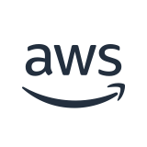
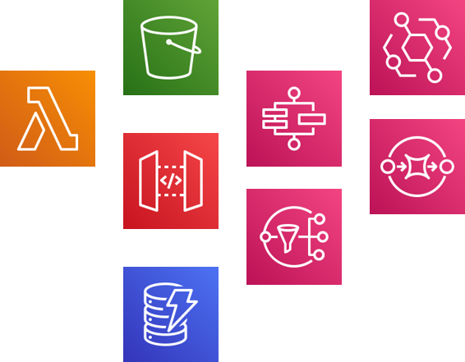
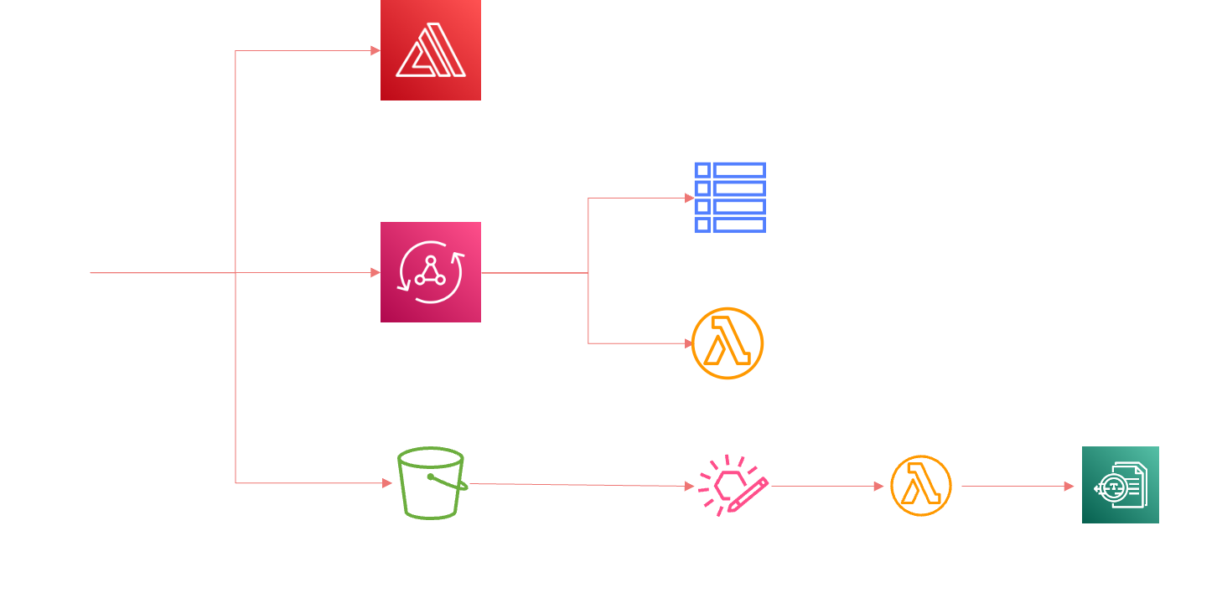
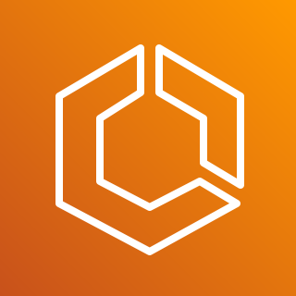
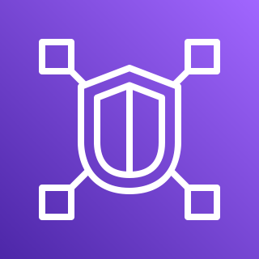
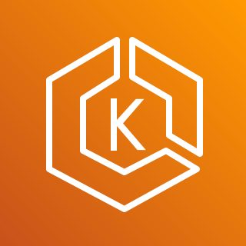
Small pieces, loosely joined
Modern application architectures are composed of multiple building blocks
AWS Cloud
Amazon VPC
Lattice
Amazon EKS
Notes:
Larger set of services involved
Govern access to these services and how permission to is governed
Need to think about the access these services should have to each other as well
Good news is that this is primarily managed via AWS IAM

Slide 8
What’s the same? What’s different?
What’s the same?
Need to secure data
Write quality code
Protect against vulnerabilities
Least privilege
Monitoring
What’s different?
Services are ephemeral
Distributed security perimeter
Support for fine-grained access controls
Tooling
Increased experimentation
Notes:
When we architect and build with managed services, we use a collection of building blocks, arranged in different ways, to implement functionality.
Beyond seeing more AWS icons or blocks on an architecture diagram, there are a few differences from how applications may have been built previously:
Service instances are ephemeral. The managed services performs the desired work and then moves on. The resources generally do not stick around as these are shared (we’ll discuss this more later). De-risk
We also have a distributed perimeter. Instead of a single application, there are multiple blocks, all of which have different security configurations that you can take advantage of. Distributed, reduced attack surface across these components.
All of these services provide fine-grained access controls using AWS IAM. Even though the perimeter is diffused, IAM remains constant. We’ll discuss more shortly.
And finally, tooling is different. We rely on frameworks like AWS SAM or CDK to manage different aspects of these applications and wire together.
What remains the same?
The need to secure your data. While encryption generally comes standard, you still need to secure your data in such a way that only desired parties have access.
We still need to write quality code and protect against vulnerable dependencies. Even though these services provides a solid basis, bad code or vulnerable dependencies can still expose your application.
Least privilege also remains critical, we’ll discuss this more later.
And finally, monitoring. In a distributed environment, we use monitoring to watch for errors and unexpected behavior. We won’t have time to explore monitoring today, but check the session catalog for other sessions.

Slide 9
Modern strategy shifts approach
Traditional strategy
Modern strategy
Heavy emphasis on perimeter security and alarms
Applications are deployed within the secured perimeter
“Security added at the end”
Centralized management
Implement defense in depth
Secure each component of the workload
Automate
Implement guardrails
Move validation to tooling
Automate remediation/notification
Build strong feedback loops from builders to security
Notes:
When we talk about what’s different in a modern or serverless architecture, let’s keep in mind the difference from a more traditional approach:
Ephemeral
Diffused perimeter
Fine-grained access controls via IAM
Tooling
But we still need to : secure data, write quality code, and follow least privilege
Traditional approach:
Emphasis on perimeter. Deploy in that secure perimeter.
Does not translate all that well. Whether a Lambda function should make use of a VPC still gets asked a lot …. We’ll get there.
Modern
Implement defense in depth, each layer
Secure each component using IAM and the other security features available
Apply perimeter security when exposing to internet using WAF, API GW, etc.
We have a strong basis but its possible to break that open. Let’s discuss some core principles for builders in your organization.

Slide 10
Our plan for today
Code signing
Live demo
AWS Config
IAM
35 mins
35 mins
15 mins
Setup
AWS Security Hub
Serverless
10 mins
15 mins
Containers
35 mins
20 mins
30 mins
AWS Config
Identity
Pod security
Notes:
Implementing governance policies and controls

Slide 11

Let’s get started!
https://s12d.com/reinforce2023-grc373

Slide 12
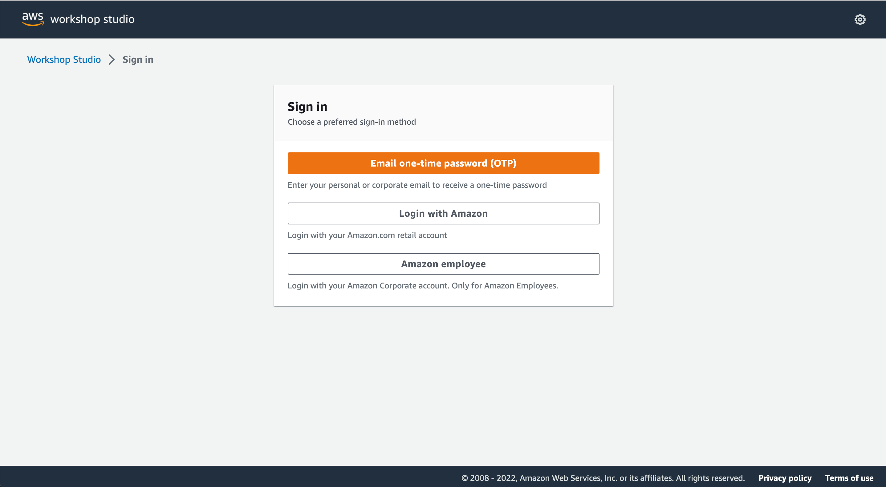
Accessing workshop content

Slide 13
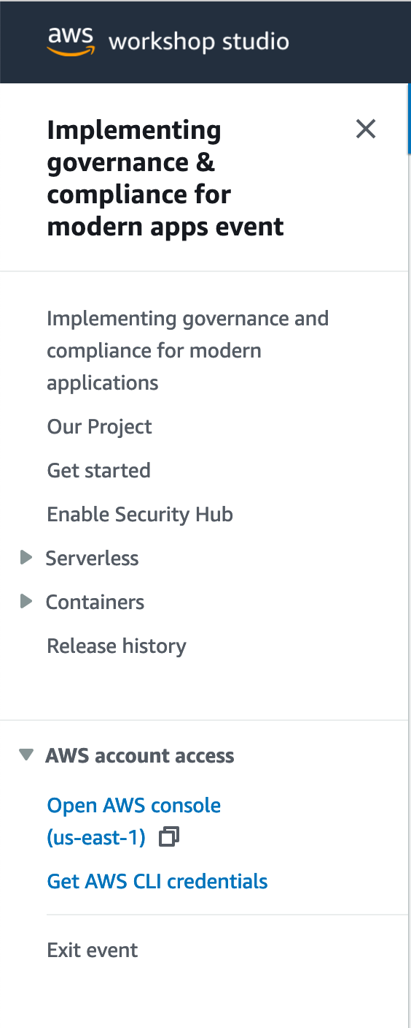
Access AWS console

Slide 14
Josh Kahn
Rodrigo Bersa
@joshuaakahn

